Slide 1
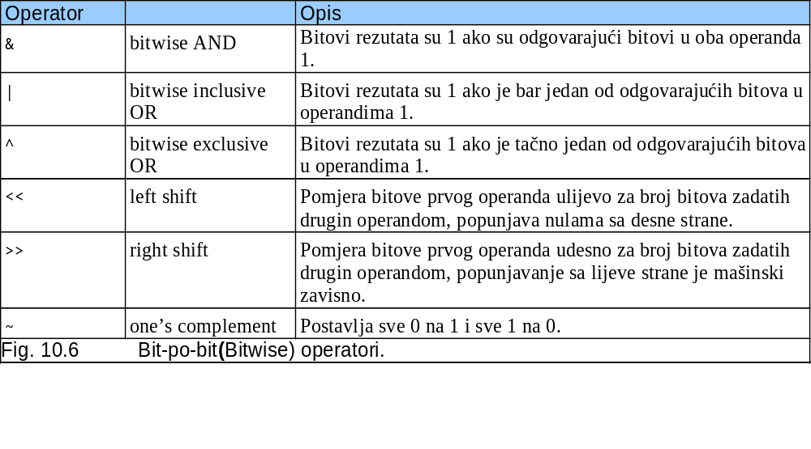
10.9 Bit-po-bit (bitwise) operatori
Svi podaci su predstavljeni kao nizovi bitova
  Svaki bit može biti 0 ili 1
  Niz od 8 bitova formira jedan bajt

Slide 2
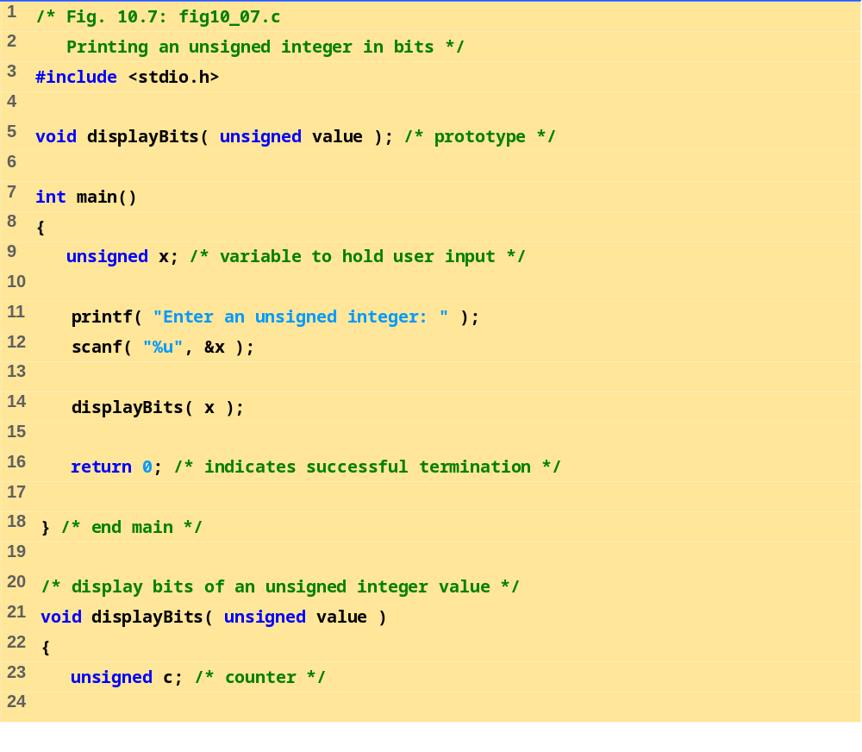
fig10_07.c (1 of 2)

Slide 3
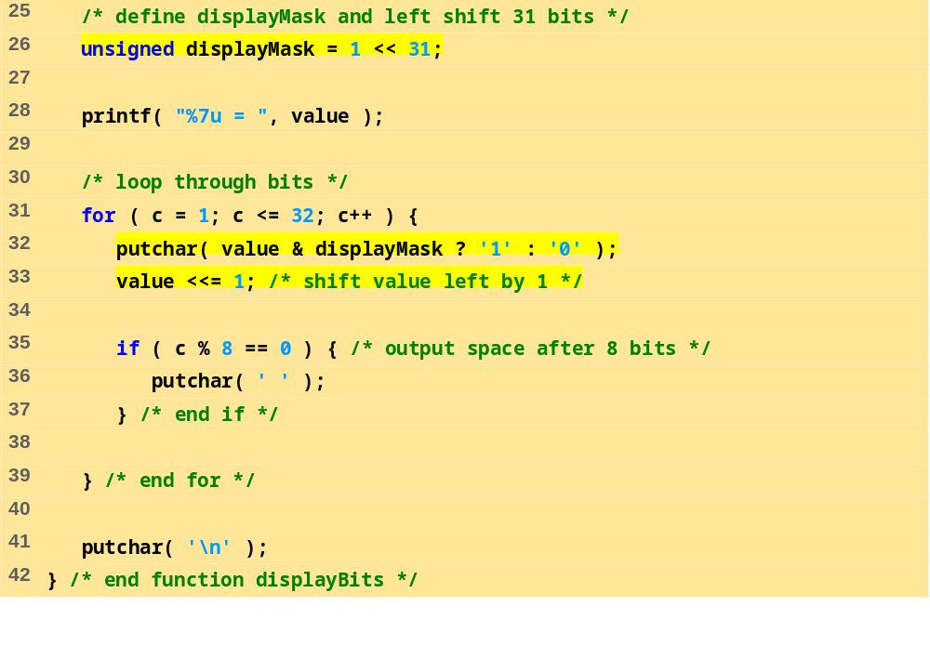
fig10_07.c (2 of 2)
Enter an unsigned integer: 65000
65000 = 00000000 00000000 11111101 11101000

Slide 4
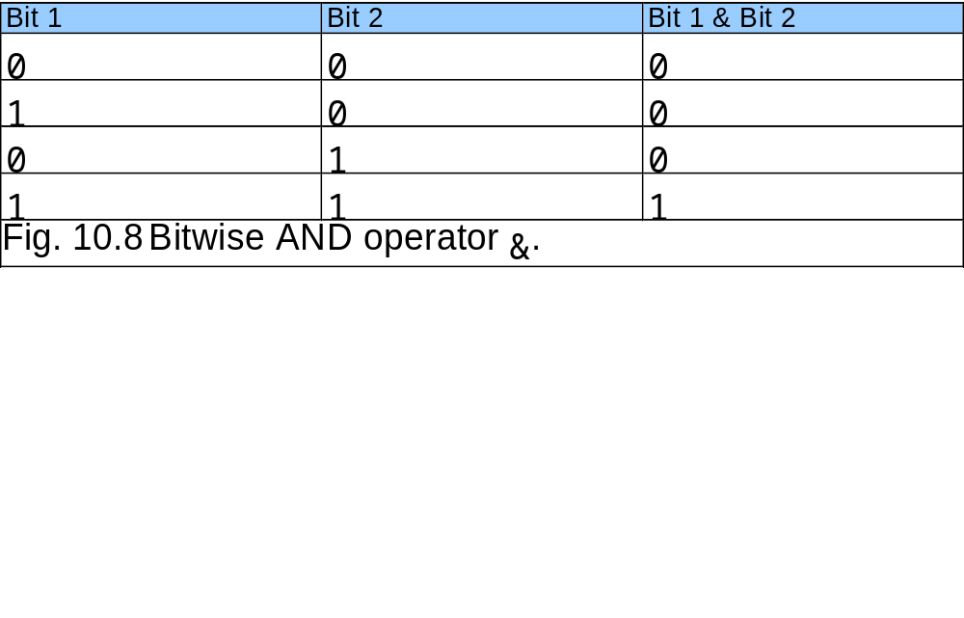
10.9 Bit-po-bit (bitwise) operatori

Slide 5
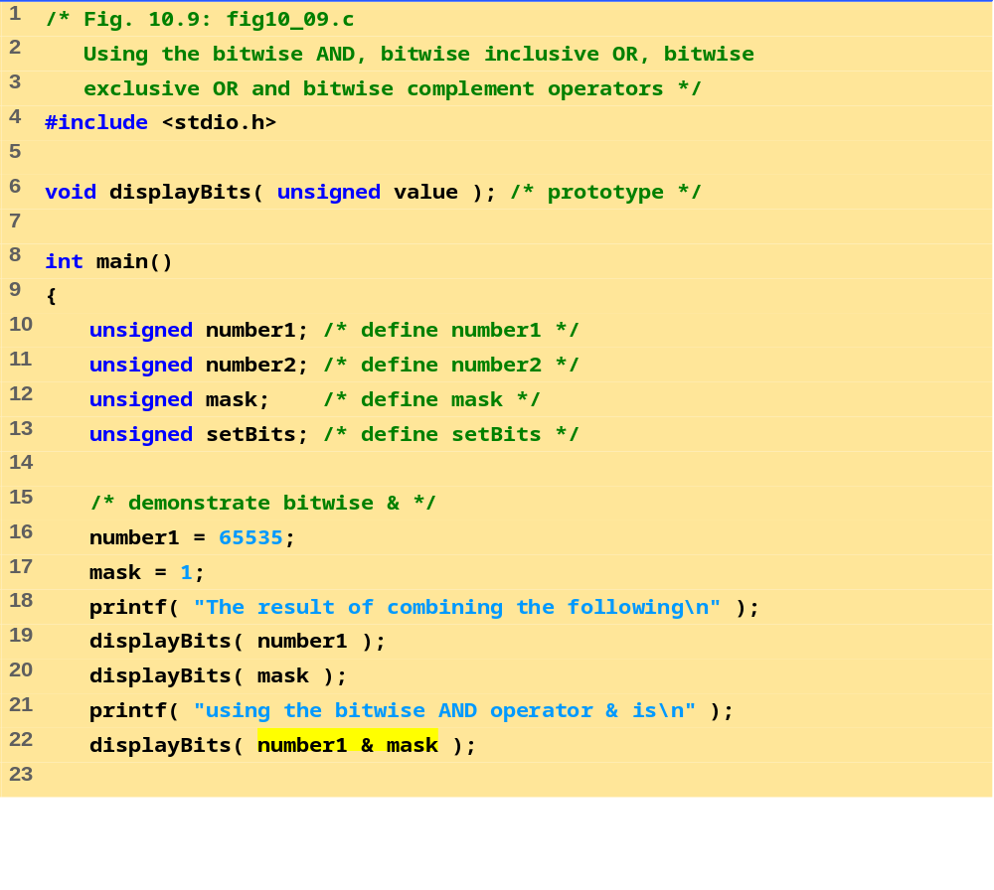
fig10_09.c (1 of 4)

Slide 6
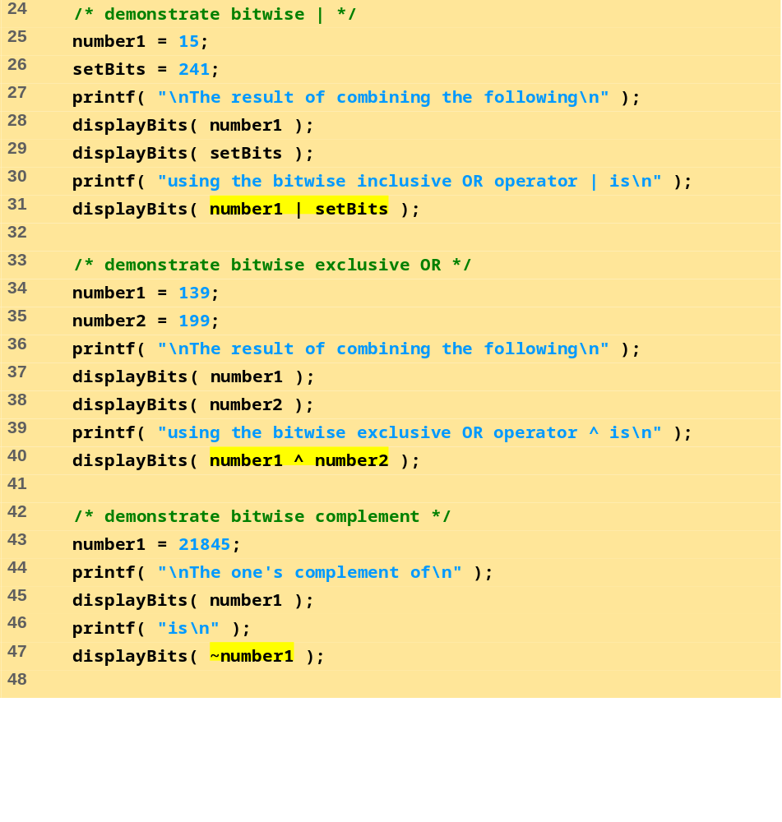
fig10_09.c (2 of 4)

Slide 7
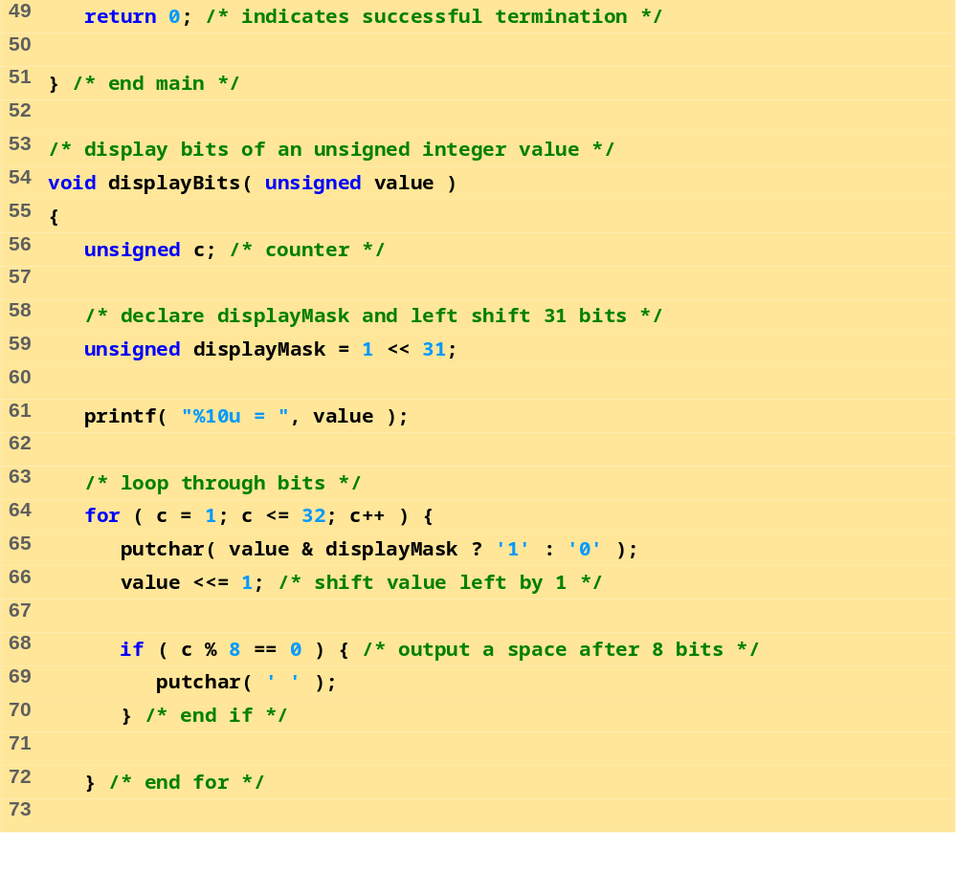
fig10_09.c (3 of 4)

Slide 8
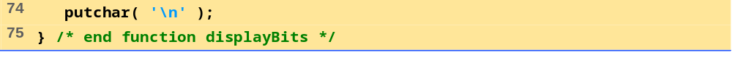
The result of combining the following
65535 = 00000000 00000000 11111111 11111111
1 = 00000000 00000000 00000000 00000001
using the bitwise AND operator & is
1 = 00000000 00000000 00000000 00000001
The result of combining the following
15 = 00000000 00000000 00000000 00001111
241 = 00000000 00000000 00000000 11110001
using the bitwise inclusive OR operator | is
255 = 00000000 00000000 00000000 11111111
The result of combining the following
139 = 00000000 00000000 00000000 10001011
199 = 00000000 00000000 00000000 11000111
using the bitwise exclusive OR operator ^ is
76 = 00000000 00000000 00000000 01001100
The one's complement of
21845 = 00000000 00000000 01010101 01010101
is
4294945450 = 11111111 11111111 10101010 10101010
fig10_09.c (4 of 4)
Program Output

Slide 9
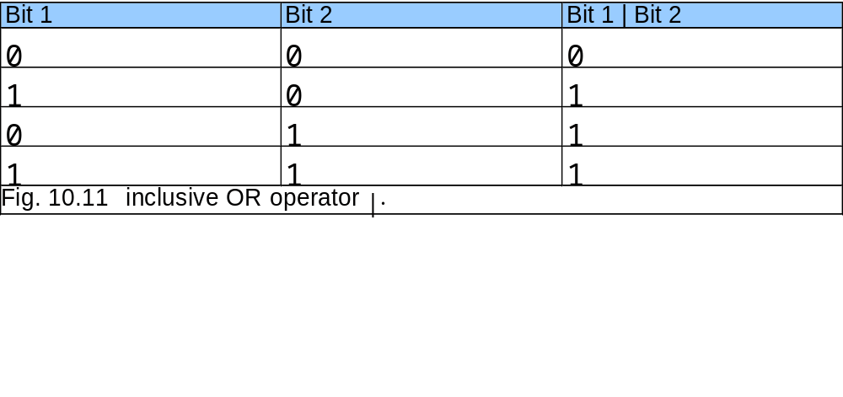
10.9 Bit-po-bit (bitwise) operatori

Slide 10
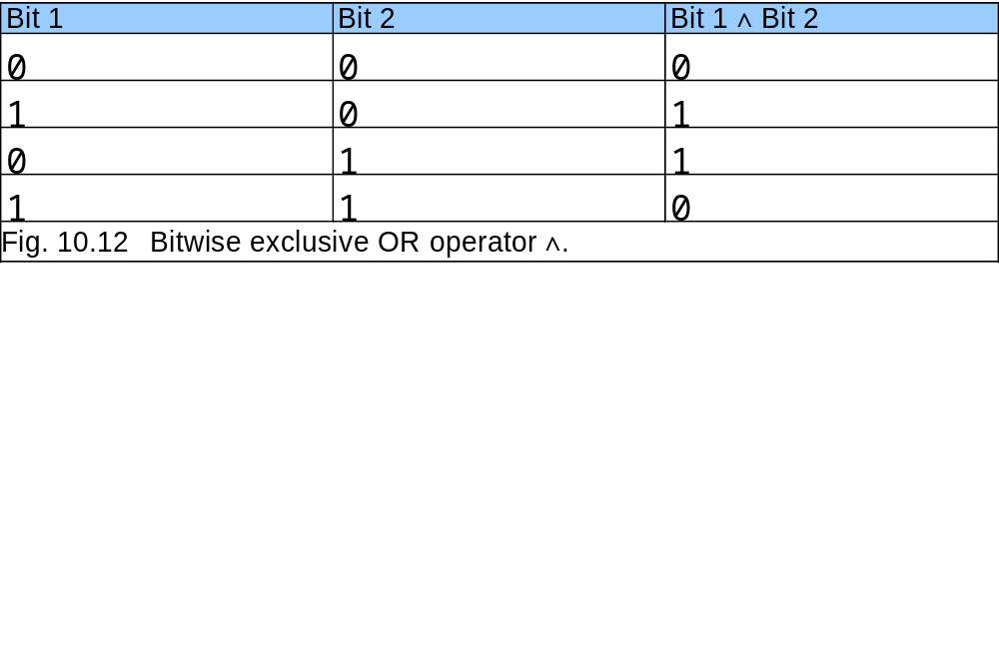
10.9 Bit-po-bit (bitwise) operatori

Slide 11
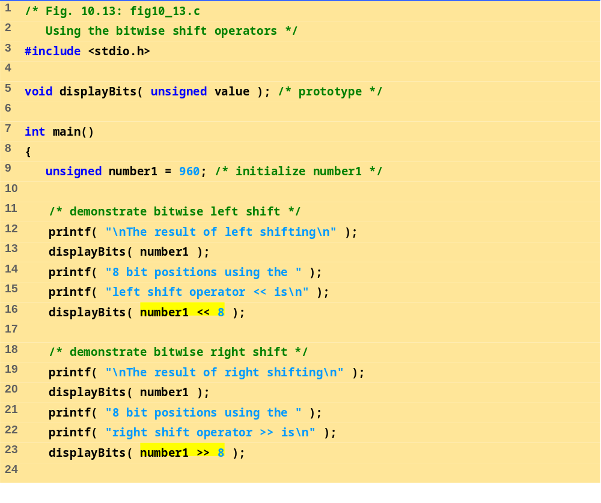
fig10_13.c (1 of 2)

Slide 12
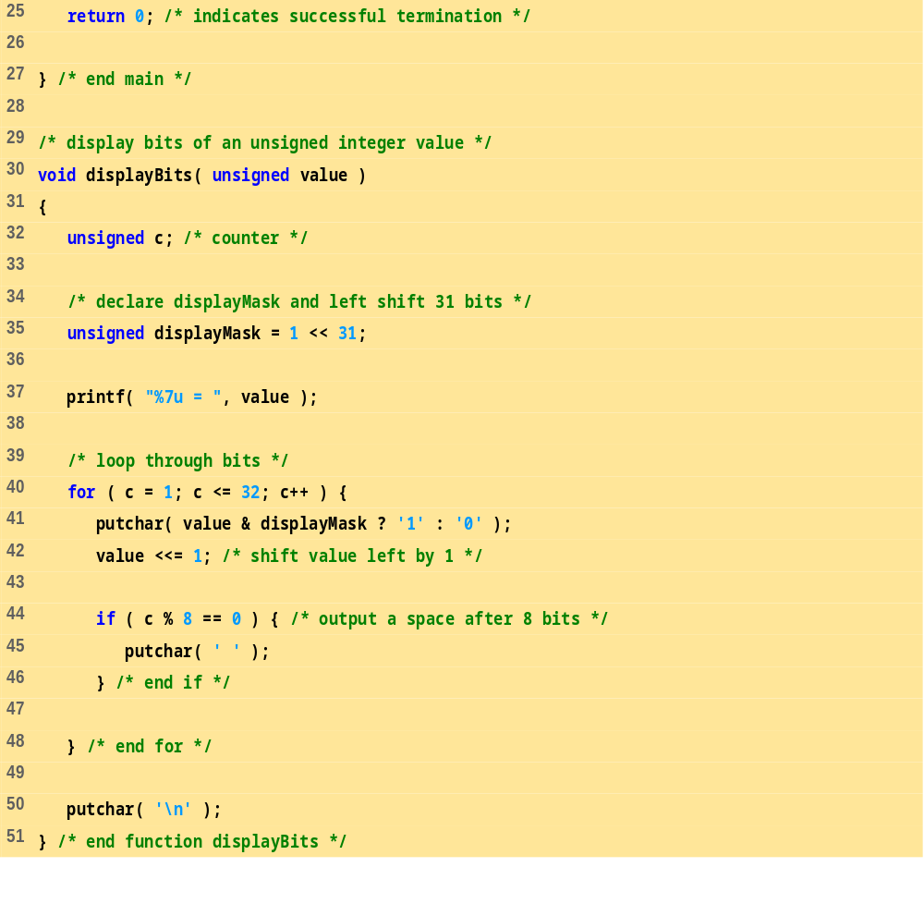
fig10_13.c (2 of 2)

Slide 13
The result of left shifting
960 = 00000000 00000000 00000011 11000000
8 bit positions using the left shift operator << is
245760 = 00000000 00000011 11000000 00000000
The result of right shifting
960 = 00000000 00000000 00000011 11000000
8 bit positions using the right shift operator >> is
3 = 00000000 00000000 00000000 00000011
Program Output

Slide 14
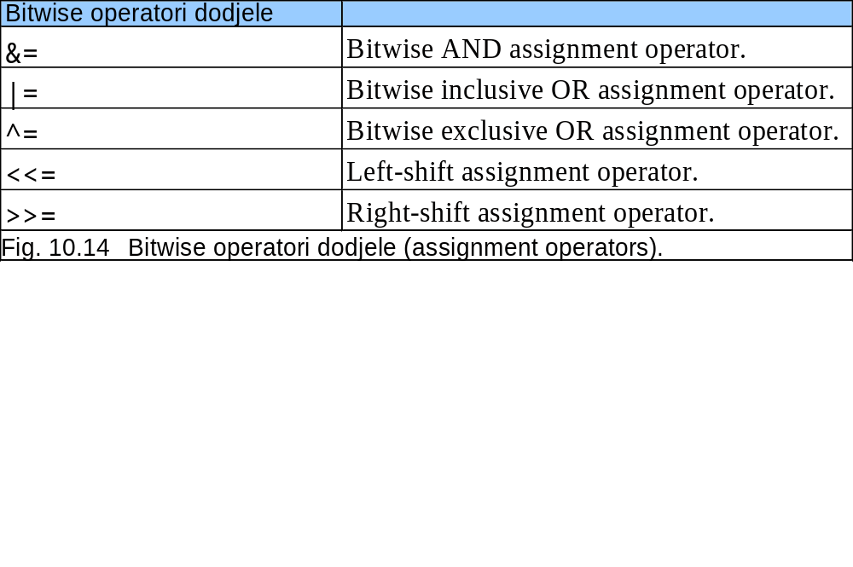
10.9 Bit-po-bit (bitwise) operatori

Slide 15
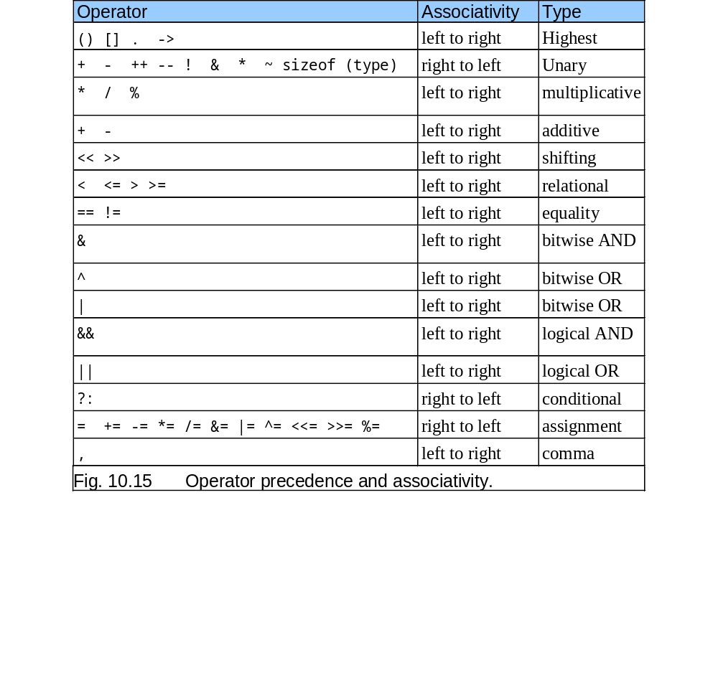
10.9 Bit-po-bit (bitwise) operatori

